Slide 1
The Sorting Problem
Input:
  A sequence of n numbers a₁, a₂, . . . , a_{n}
Output:
  A permutation (reordering) a₁’, a₂’, . . . , a_{n}’ of the input sequence such that a₁’ ≤ a₂’ ≤ · · · ≤ a_{n}’
Logipool Infotech Pvt. Ltd.
Notes:
Logipool Infotech Pvt. Ltd.

Slide 2
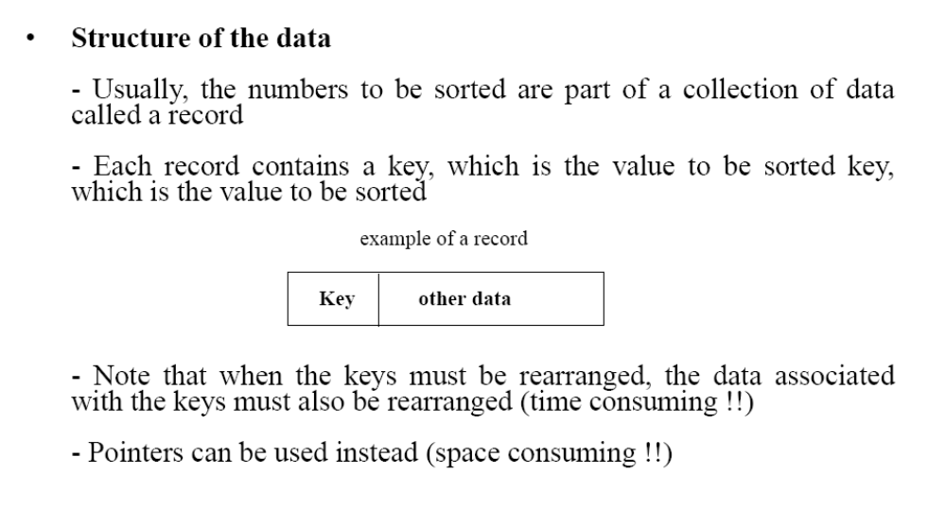
Structure of data
Logipool Infotech Pvt. Ltd.
Notes:
Logipool Infotech Pvt. Ltd.

Slide 3
Why Study Sorting Algorithms?
There are a variety of situations that we can encounter
  Do we have randomly ordered keys?
  Are all keys distinct?
  How large is the set of keys to be ordered?
  Need guaranteed performance?
Various algorithms are better suited to some of these situations
Logipool Infotech Pvt. Ltd.
Notes:
Logipool Infotech Pvt. Ltd.

Slide 4
Some Definitions
Internal Sort
  The data to be sorted is all stored in the computer’s main memory.
External Sort
  Some of the data to be sorted might be stored in some external, slower, device.
In Place Sort
  The amount of extra space required to sort the data is constant with the input size.
Logipool Infotech Pvt. Ltd.
Notes:
Logipool Infotech Pvt. Ltd.

Slide 5
Insertion Sort
Idea: like sorting a hand of playing cards
  Start with an empty left hand and the cards facing down on the table.
  Remove one card at a time from the table, and insert it into the correct position in the left hand
    compare it with each of the cards already in the hand, from right to left
  The cards held in the left hand are sorted
    these cards were originally the top cards of the pile on the table
Logipool Infotech Pvt. Ltd.
Notes:
Logipool Infotech Pvt. Ltd.

Slide 6
Insertion Sort
To insert 12, we need to make room for it by moving first 36 and then 24.
6
10
24
36
12
Logipool Infotech Pvt. Ltd.
Notes:
Logipool Infotech Pvt. Ltd.

Slide 7
Insertion Sort
6
10
24
36
12
Logipool Infotech Pvt. Ltd.
Notes:
Logipool Infotech Pvt. Ltd.

Slide 8
Insertion Sort
6
10
24
36
12
Logipool Infotech Pvt. Ltd.
Notes:
Logipool Infotech Pvt. Ltd.

Slide 9
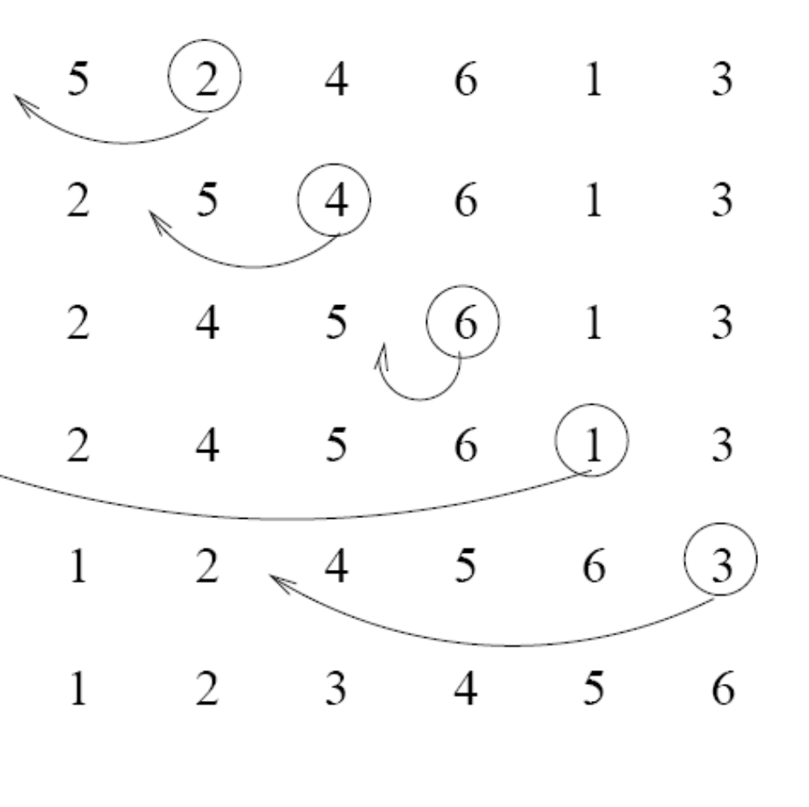
Insertion Sort
input array
5 2 4 6 1 3
at each iteration, the array is divided in two sub-arrays:
left sub-array
right sub-array
sorted
unsorted
Logipool Infotech Pvt. Ltd.
Notes:
Logipool Infotech Pvt. Ltd.

Slide 10





Insertion Sort
Logipool Infotech Pvt. Ltd.
Notes:
Logipool Infotech Pvt. Ltd.

Slide 11
INSERTION-SORT
Alg.: INSERTION-SORT(A)
for j ← 2 to n
do key ← A[ j ]
Insert A[ j ] into the sorted sequence A[1 . . j -1]
i ← j - 1
while i > 0 and A[i] > key
do A[i + 1] ← A[i]
i ← i – 1
A[i + 1] ← key
Insertion sort – sorts the elements in place
1
2
3
4
5
6
7
8
a₁
a₂
a₃
a₄
a₅
a₆
a₇
a₈
key
Logipool Infotech Pvt. Ltd.
Notes:
Logipool Infotech Pvt. Ltd.

Slide 12
Loop Invariant for Insertion Sort
Alg.: INSERTION-SORT(A)
for j ← 2 to n
do key ← A[ j ]
Insert A[ j ] into the sorted sequence A[1 . . j -1]
i ← j - 1
while i > 0 and A[i] > key
do A[i + 1] ← A[i]
i ← i – 1
A[i + 1] ← key
Invariant: at the start of the for loop the elements in A[1 . . j-1] are in sorted order
Logipool Infotech Pvt. Ltd.
Notes:
Logipool Infotech Pvt. Ltd.

Slide 13
Proving Loop Invariants
Proving loop invariants works like induction
Initialization (base case):
  It is true prior to the first iteration of the loop
Maintenance (inductive step):
  If it is true before an iteration of the loop, it remains true before the next iteration
Termination:
  When the loop terminates, the invariant gives us a useful property that helps show that the algorithm is correct
  Stop the induction when the loop terminates
Logipool Infotech Pvt. Ltd.
Notes:
Logipool Infotech Pvt. Ltd.

Slide 14
Loop Invariant for Insertion Sort
Initialization:
  Just before the first iteration, j = 2:
  the subarray A[1 . . j-1] = A[1], (the element originally in A[1]) – is sorted
Logipool Infotech Pvt. Ltd.
Notes:
Logipool Infotech Pvt. Ltd.

Slide 15
Loop Invariant for Insertion Sort
Maintenance:
  the while inner loop moves A[j -1], A[j -2], A[j -3], and so on, by one position to the right until the proper position for key (which has the value that started out in A[j]) is found
  At that point, the value of key is placed into this position.
Logipool Infotech Pvt. Ltd.
Notes:
Logipool Infotech Pvt. Ltd.

Slide 16

Loop Invariant for Insertion Sort
Termination:
  The outer for loop ends when j = n + 1 ⇒ j-1 = n
  Replace n with j-1 in the loop invariant:
    the subarray A[1 . . n] consists of the elements originally in A[1 . . n], but in sorted order
The entire array is sorted!
j - 1
j
Invariant: at the start of the for loop the elements in A[1 . . j-1] are in sorted order
Logipool Infotech Pvt. Ltd.
Notes:
Logipool Infotech Pvt. Ltd.

Slide 17


Analysis of Insertion Sort
INSERTION-SORT(A)
for j ← 2 to n
do key ← A[ j ]
Insert A[ j ] into the sorted sequence A[1 . . j -1]
i ← j - 1
while i > 0 and A[i] > key
do A[i + 1] ← A[i]
i ← i – 1
A[i + 1] ← key
cost times
c₁ n
c₂ n-1
0 n-1
c₄ n-1
c₅
c₆
c₇
c₈ n-1
t_{j}: # of times the while statement is executed at iteration j
Logipool Infotech Pvt. Ltd.
Notes:
₇
Logipool Infotech Pvt. Ltd.

Slide 18
Comparisons and Exchanges in Insertion Sort
INSERTION-SORT(A)
for j ← 2 to n
do key ← A[ j ]
Insert A[ j ] into the sorted sequence A[1 . . j -1]
i ← j - 1
while i > 0 and A[i] > key
do A[i + 1] ← A[i]
i ← i – 1
A[i + 1] ← key
cost times
c₁ n
c₂ n-1
0 n-1
c₄ n-1
c₅
c₆
c₇
c₈ n-1
≈ n²/2 comparisons
≈ n²/2 exchanges
Logipool Infotech Pvt. Ltd.
Notes:
Logipool Infotech Pvt. Ltd.

Slide 19
Insertion Sort
Advantages
  Good running time for “almost sorted” arrays Θ(n)
Disadvantages
  Θ(n²) running time in worst and average case
  ≈ n²/2 comparisons and exchanges
Logipool Infotech Pvt. Ltd.
Notes:
Logipool Infotech Pvt. Ltd.

Slide 20
Bubble Sort
Idea:
  Repeatedly pass through the array
  Swaps adjacent elements that are out of order
Easier to implement, but slower than Insertion sort
i
1
2
3
n
8
4
6
9
2
3
1
j
Logipool Infotech Pvt. Ltd.
Notes:
Logipool Infotech Pvt. Ltd.

Slide 21
Example
8
4
6
9
2
3
1
1
8
4
6
9
2
3
i = 1
j
i = 2
j
8
4
6
9
2
1
3
1
2
8
4
6
9
3
i = 1
j
i = 3
j
8
4
6
9
1
2
3
1
2
3
8
4
6
9
i = 1
j
i = 4
j
8
4
6
1
9
2
3
1
2
3
4
8
6
9
i = 1
j
i = 5
j
8
4
1
6
9
2
3
1
2
3
4
6
8
9
i = 1
j
i = 6
j
8
1
4
6
9
2
3
1
2
3
4
6
8
9
i = 1
j
i = 7
1
8
4
6
9
2
3
j
Logipool Infotech Pvt. Ltd.
i = 1
j
Notes:
Logipool Infotech Pvt. Ltd.

Slide 22
Bubble Sort
Alg.: BUBBLESORT(A)
for i ← 1 to length[A]
do for j ← length[A] downto i + 1
do if A[j] < A[j -1]
then exchange A[j] ↔ A[j-1]
i
8
4
6
9
2
3
1
i = 1
j
Logipool Infotech Pvt. Ltd.
Notes:
Logipool Infotech Pvt. Ltd.

Slide 23




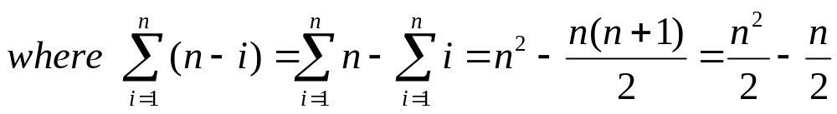
Bubble-Sort Running Time
Alg.: BUBBLESORT(A)
for i ← 1 to length[A]
do for j ← length[A] downto i + 1
do if A[j] < A[j -1]
then exchange A[j] ↔ A[j-1]
c₁
c₂
Comparisons: ≈ n²/2
c₃
c₄
Exchanges: ≈ n²/2
T(n) =
c₁(n+1) +
c₂
c₃
c₄
= Θ(n) +
(c₂ + c₂ + c₄)
Thus,T(n) = Θ(n²)
Notes:
Logipool Infotech Pvt. Ltd.

Slide 24
Selection Sort
Idea:
  Find the smallest element in the array
  Exchange it with the element in the first position
  Find the second smallest element and exchange it with the element in the second position
  Continue until the array is sorted
Disadvantage:
  Running time depends only slightly on the amount of order in the file
Logipool Infotech Pvt. Ltd.
Notes:
Logipool Infotech Pvt. Ltd.

Slide 25
Example
8
4
6
9
2
3
1
1
2
3
4
9
6
8
1
4
6
9
2
3
8
1
2
3
4
6
9
8
1
2
6
9
4
3
8
1
2
3
4
6
8
9
1
2
3
9
4
6
8
1
2
3
4
6
8
9
Logipool Infotech Pvt. Ltd.
Notes:
Logipool Infotech Pvt. Ltd.

Slide 26
Selection Sort
Alg.: SELECTION-SORT(A)
n ← length[A]
for j ← 1 to n - 1
do smallest ← j
for i ← j + 1 to n
do if A[i] < A[smallest]
then smallest ← i
exchange A[j] ↔ A[smallest]
8
4
6
9
2
3
1
Logipool Infotech Pvt. Ltd.
Notes:
Logipool Infotech Pvt. Ltd.

Slide 27


Analysis of Selection Sort
Alg.: SELECTION-SORT(A)
n ← length[A]
for j ← 1 to n - 1
do smallest ← j
for i ← j + 1 to n
do if A[i] < A[smallest]
then smallest ← i
exchange A[j] ↔ A[smallest]
cost times
c₁ 1
c₂ n
c₃ n-1
c₄
c₅
c₆
c₇ n-1
n²/2
comparisons
n
exchanges
Logipool Infotech Pvt. Ltd.
Notes:
Logipool Infotech Pvt. Ltd.

Slide 28
Menu
Sorting!
  Insertion Sort
  Merge Sort
Solving Recurrences
Logipool Infotech Pvt. Ltd.

Slide 29
The problem of sorting
Input: array A[1…n] of numbers.
Output: permutation B[1…n] of A such that B[1] ≤ B[2] ≤ … ≤ B[n] .
e.g. A = [7, 2, 5, 5, 9.6] → B = [2, 5, 5, 7, 9.6]
How can we do it efficiently ?
Logipool Infotech Pvt. Ltd.

Slide 30
Why Sorting?
Obvious applications
  Organize an MP3 library
  Maintain a telephone directory
Problems that become easy once items are in sorted order
  Find a median, or find closest pairs
  Binary search, identify statistical outliers
Non-obvious applications
  Data compression: sorting finds duplicates
  Computer graphics: rendering scenes front to back
Logipool Infotech Pvt. Ltd.

Slide 31
Insertion sort
INSERTION-SORT (A, n)
for j ← 2 to n
[ A[1 . . n]
insert key A[j] into the (already sorted) sub-array A[1 .. j-1]. by pairwise key-swaps down to its right position
Illustration of iteration j
1 i
j
n
A:
key
sorted
new location of key
Logipool Infotech Pvt. Ltd.

Slide 32
Example of insertion sort
8 2 4 9 3 6
Logipool Infotech Pvt. Ltd.

Slide 33
Example of insertion sort
8 2 4 9 3 6
Logipool Infotech Pvt. Ltd.

Slide 34
Example of insertion sort
8 2 4 9 3 6
2 8 4 9 3 6
Logipool Infotech Pvt. Ltd.

Slide 35
Example of insertion sort
8 2 4 9 3 6
2 8 4 9 3 6
Logipool Infotech Pvt. Ltd.

Slide 36
Example of insertion sort
8 | 2 | 4 | 9 | 3 | 6
2 | 8 | 4 | 9 | 3 | 6
2 | 4 | 8 | 9 | 3 | 6
Logipool Infotech Pvt. Ltd.

Slide 37
Example of insertion sort
8 | 2 | 4 | 9 | 3 | 6
2 | 8 | 4 | 9 | 3 | 6
2 | 4 | 8 | 9 | 3 | 6
Logipool Infotech Pvt. Ltd.

Slide 38
Example of insertion sort
8 | 2 | 4 | 9 | 3 | 6
2 | 8 | 4 | 9 | 3 | 6
2 | 4 | 8 | 9 | 3 | 6
2 | 4 | 8 | 9 | 3 | 6
Logipool Infotech Pvt. Ltd.

Slide 39
Example of insertion sort
8 | 2 | 4 | 9 | 3 | 6
2 | 8 | 4 | 9 | 3 | 6
2 | 4 | 8 | 9 | 3 | 6
2 | 4 | 8 | 9 | 3 | 6
Logipool Infotech Pvt. Ltd.

Slide 40
Example of insertion sort
8 | 2 | 4 | 9 | 3 | 6
2 | 8 | 4 | 9 | 3 | 6
2 | 4 | 8 | 9 | 3 | 6
2 | 4 | 8 | 9 | 3 | 6
2 | 3 | 4 | 8 | 9 | 6
Logipool Infotech Pvt. Ltd.

Slide 41
Example of insertion sort
8 | 2 | 4 | 9 | 3 | 6
2 | 8 | 4 | 9 | 3 | 6
2 | 4 | 8 | 9 | 3 | 6
2 | 4 | 8 | 9 | 3 | 6
2 | 3 | 4 | 8 | 9 | 6
Logipool Infotech Pvt. Ltd.

Slide 42
Example of insertion sort
8 | 2 | 4 | 9 | 3 | 6
2 | 8 | 4 | 9 | 3 | 6
2 | 4 | 8 | 9 | 3 | 6
2 | 4 | 8 | 9 | 3 | 6
2 | 3 | 4 | 8 | 9 | 6
2 | 3 | 4 | 6 | 8 | 9 | done
Running time? Θ(n²) because Θ(n²) compares and Θ(n²) swaps
e.g. when input is A = [n, n − 1, n − 2, . . . , 2, 1]
Logipool Infotech Pvt. Ltd.

Slide 43
Binary Insertion sort
BINARY-INSERTION-SORT (A, n)
for j ← 2 to n
[ A[1 . . n]
insert key A[j] into the (already sorted) sub-array A[1 .. j-1]. Use binary search to find the right position
Binary search with take Θ(log n) time.
However, shifting the elements after insertion will still take Θ(n) time.
Complexity: Θ(n log n) comparisons
(n²) swaps
Logipool Infotech Pvt. Ltd.

Slide 44
Meet Merge Sort
MERGE-SORT A[1 . . n]
If n = 1, done (nothing to sort).
Otherwise, recursively sort A[ 1 . . n/2 ] and A[ n/2+1 . . n ] .
“Merge” the two sorted sub-arrays.
divide and conquer
Key subroutine: MERGE
Logipool Infotech Pvt. Ltd.

Slide 45
Merging two sorted arrays
20 12
13 11
7 9
2 1
Logipool Infotech Pvt. Ltd.

Slide 46
Merging two sorted arrays
20 12
13 11
7 9
2 1
1
Logipool Infotech Pvt. Ltd.

Slide 47
Merging two sorted arrays
20 | 12
13 | 11
7 | 9
20 | 12
13 | 11
7 | 9
2 1
2
1
Logipool Infotech Pvt. Ltd.

Slide 48
Merging two sorted arrays
20 | 12 | 20 | 12
13 | 11 | 13 | 11
7 2 | 9 1 | 7 2 | 9
1
2
Logipool Infotech Pvt. Ltd.

Slide 49
Merging two sorted arrays
20 | 12 | 20 | 12
13 | 11 | 13 | 11
7 2 | 9 1 | 7 2 | 9
20 12
13 11
7 9
1
2
Logipool Infotech Pvt. Ltd.

Slide 50
Merging two sorted arrays
20 | 12
13 | 11
7 | 9
20 12 20 12
13 11 13 11
7 9 7 9
2
2 1
1
2
7
Logipool Infotech Pvt. Ltd.

Slide 51
Merging two sorted arrays
20 | 12 | 20 | 12
13 | 11 | 13 | 11
7 2 | 9 1 | 7 2 | 9
20 12 20 12
13 11 13 11
7 9 9
1
2
7
Logipool Infotech Pvt. Ltd.

Slide 52
Merging two sorted arrays
20 | 12
13 | 11
7 | 9
20 12 20 12 20 12
13 11 13 11 13 11
7 9 7 9 9
2
2 1
1
2
7
9
Logipool Infotech Pvt. Ltd.

Slide 53
Merging two sorted arrays
20 | 12
13 | 11
7 | 9
20 12 20 12 20 12 20 12
13 11 13 11 13 11 13 11
7 9 7 9 9
2
2 1
1
2
7
9
Logipool Infotech Pvt. Ltd.

Slide 54
Merging two sorted arrays
20 | 12
13 | 11
7 | 9
20 12 20 12 20 12 20 12
13 11 13 11 13 11 13 11
7 9 7 9 9
2
2 1
1
2
7
9
11
Logipool Infotech Pvt. Ltd.

Slide 55
Merging two sorted arrays
20 | 12
13 | 11
7 | 9
20 12 20 12 20 12 20 12 20 12
13 11 13 11 13 11 13 11 13
7 9 7 9 9
2
2 1
1
2
7
9
11
Logipool Infotech Pvt. Ltd.

Slide 56
Merging two sorted arrays
20 | 12
13 | 11
7 | 9
20 12 20 12 20 12 20 12 20 12
13 11 13 11 13 11 13 11 13
7 9 7 9 9
2
2 1
1
2
7
9
11
12
Logipool Infotech Pvt. Ltd.

Slide 57
Merging two sorted arrays
20 | 12 | 20 | 12 | 20 | 12 | 20 | 12 | 20 | 12 | 20 | 12
13 | 11 | 13 | 11 | 13 | 11 | 13 | 11 | 13 | 11 | 13
7 | 9 | 7 | 9 | 7 | 9 |  | 9
2 | 1 | 2
1
2 7 9 11
Time = Θ(n) to merge a total of n elements (linear time).
12
Logipool Infotech Pvt. Ltd.

Slide 58
Analyzing merge sort
MERGE-SORT A[1 . . n]
If n = 1, done.
Recursively sort A[ 1 . . ⎡n/2⎤ ] and A[ ⎡n/2⎤+1 . . n ] .
“Merge” the two sorted lists
T(n)
Θ(1) 2T(n/2)
Θ(n)
Θ(1) if n = 1;
2T(n/2) + Θ(n) if n > 1.
T(n) =
T(n) = ?
Logipool Infotech Pvt. Ltd.

Slide 59
Recurrence solving
Solve T(n) = 2T(n/2) + cn, where c > 0 is constant.
Logipool Infotech Pvt. Ltd.

Slide 60
Recursion tree
Solve T(n) = 2T(n/2) + cn, where c > 0 is constant.
T(n)
Logipool Infotech Pvt. Ltd.

Slide 61
Recursion tree
Solve T(n) = 2T(n/2) + cn, where c > 0 is constant.
cn
T(n/2) T(n/2)
Logipool Infotech Pvt. Ltd.

Slide 62
Recursion tree
Solve T(n) = 2T(n/2) + cn, where c > 0 is constant.
cn
cn/2
cn/2
T(n/4)
T(n/4)
T(n/4)
T(n/4)
Logipool Infotech Pvt. Ltd.

Slide 63
Recursion tree
Solve T(n) = 2T(n/2) + cn, where c > 0 is constant.
cn
cn/2
cn/2
cn/4
cn/4
cn/4
cn/4
Θ(1)
Logipool Infotech Pvt. Ltd.

Slide 64
Recursion tree
Solve T(n) = 2T(n/2) + cn, where c > 0 is constant.
cn
h = 1 + lg n
cn/2
cn/2
cn/4
cn/4
cn/4
cn/4
Θ(1)
Logipool Infotech Pvt. Ltd.

Slide 65
Recursion tree
Solve T(n) = 2T(n/2) + cn, where c > 0 is constant.
cn cn
h = 1 + lg n
cn/2
cn/2
cn/4
cn/4
cn/4
cn/4
Θ(1)
Logipool Infotech Pvt. Ltd.

Slide 66
Recursion
Solve T(n) = 2T(n/2) + cn, where c > 0 is constant.
cn cn
cn
h = 1 + lg n
cn/2
cn/2
cn/4
cn/4
cn/4
cn/4
Θ(1)
Logipool Infotech Pvt. Ltd.

Slide 67

Recursion tree
cn cn
cn/2 cn
cn
Solve T(n) = 2T(n/2) + cn, where c > 0 is constant.
h = 1 + lg n
cn/2
cn/4
cn/4
cn/4
cn/4
Θ(1)
Logipool Infotech Pvt. Ltd.

Slide 68


Recursion tree
cn cn
cn/2 cn
cn
Solve T(n) = 2T(n/2) + cn, where c > 0 is constant.
h = 1 + lg n
cn/2
cn/4
cn/4
cn/4
cn/4
Θ(1)
#leaves = n
Θ(n)
Logipool Infotech Pvt. Ltd.

Slide 69
Recursion tree
cn cn
cn/2 cn
cn
Solve T(n) = 2T(n/2) + cn, where c > 0 is constant.
h = 1 + lg n
cn/2
cn/4
cn/4
cn/4
cn/4
Θ(1)
#leaves = n
Θ(n)
Total ?
Logipool Infotech Pvt. Ltd.

Slide 70
Recursion tree
cn cn
cn/2 cn
cn
Solve T(n) = 2T(n/2) + cn, where c > 0 is constant.
h
= 1 + lg n
cn/2
cn/4
cn/4
cn/4
cn/4
Θ(1) #leaves = n Θ(n) Total = Θ(n lg n)
Equal amount of work done at each level
Logipool Infotech Pvt. Ltd.

Slide 71

Tree for different recurrence
Solve T(n) = 2T(n/2) + c, where c > 0 is constant.
c c
2c 4c
c
c
h = 1 + lg n
c
c
c
c
n/2 c
Θ(1)
#leaves = n
Θ(n)
Note that 1 + ½ + ¼ + … < 2
Total = Θ(n)
All the work done at the leaves
<number>
Logipool Infotech Pvt. Ltd.

Slide 72
Tree for yet another recurrence
Solve T(n) = 2T(n/2) + cn², c > 0 is constant.
cn² cn²
cn²/4 cn²/2
h = 1 + lg n
cn²/4
cn²/16
_{cn}2/16
_{cn}2/16 _{cn}2/16 _{cn}2_{/4}
Θ(1)
#leaves = n
Θ(n)
Note that 1 + ½ + ¼ + … < 2
Total = Θ(n²)
All the work done at the root
<number>
Logipool Infotech Pvt. Ltd.

